Slide 1















Atom Mail
Ai-Powered Email Assistant
Team Name :- Codebyte Acers
Event:- Hack/ <Fest’25 IIT Dhanbad (ISM)
Team Members :
Akshat kumar (Group leader)
Samir Sonkar
Sumist kumar Khatri
Sunny Kumar Suman

Slide 2

Origin of the creative idea
The creative idea emerged from observing the growing challenge of email overload in modern workplaces. With users spending nearly 28% of their time managing emails, there was a clear need for a smarter, faster, and personalized solution. Inspired by recent advancements in AI language models (like ChatGPT).
we envisioned integrating context-aware AI within Atom Mail to automate routine communication tasks, generate smart replies, and adapt writing styles — creating a human-like assistant inside the inbox. This idea aligns with GoFloww's vision of building AI-powered tools that boost productivity and simplify business operations

Slide 3

The Email Struggle is Real
Writing emails is time-consuming and repetitive.
Manual drafting lacks consistency and personalization.
Security and history tracking are often overlooked.

Slide 4
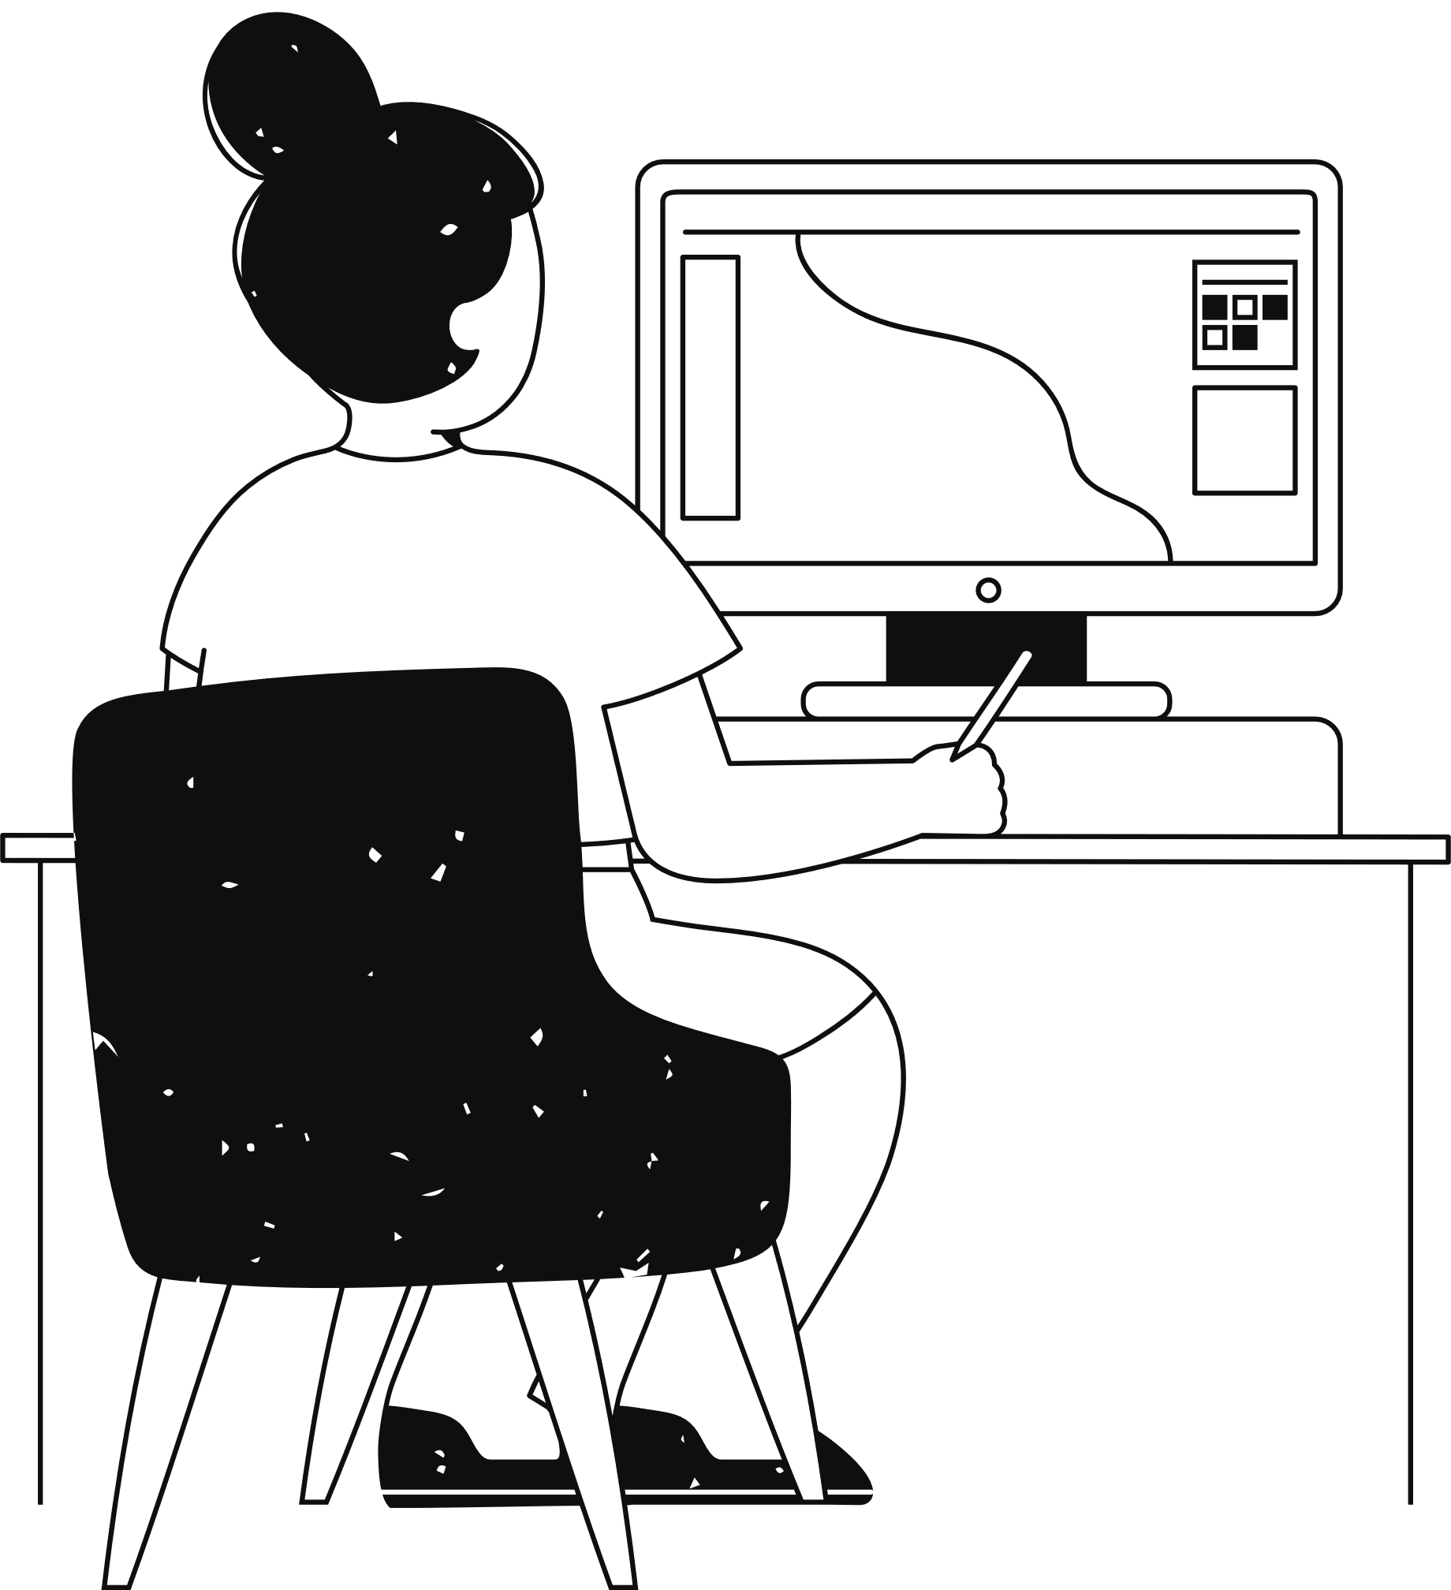
Introducing
Atom Mail
An AI-driven email assistant built with Flask and Gemini API
Generate, refine, and send emails effortlessly.
Secure, smart, and user-friendly.

Slide 5

What Make AtomMail Stand Out
AI Email Generation: Craft emails with tone customization (e.g., professional, casual).
Smart Suggestions: Reply suggestions based on context and history.
Grammar & Refinement: Auto-corrects and refines text for clarity.
Encrypted History: Securely stores email history with Fernet encryption.
User Preferences: Personalized tone, signatures, and phrases.

Slide 6
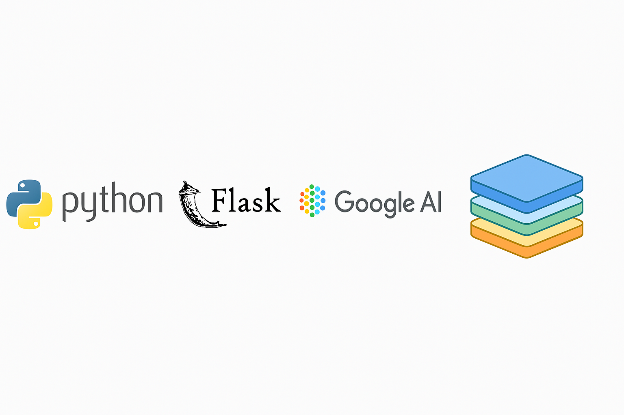
Under the Hood
Frontend: HTML, CSS, JavaScript (Flask templates).
Backend: Python, Flask, SMTP for email sending.
AI: Google Gemini API for content generation.
NLP: Sentence Transformers for embeddings, LanguageTool for grammar.
Security: Cryptography (Fernet) for encryption.

Slide 7
From Prompt to Inbox
01
02
03
04
05
Users input a prompt
( e.g. “Apology for Delay” )
AI generates a draft using Gemini API and past email embeddings.
Grammer tools refine the text.
Email is encrypted and save to History.
Sent via SMPT with
user preferences applied.

Slide 8
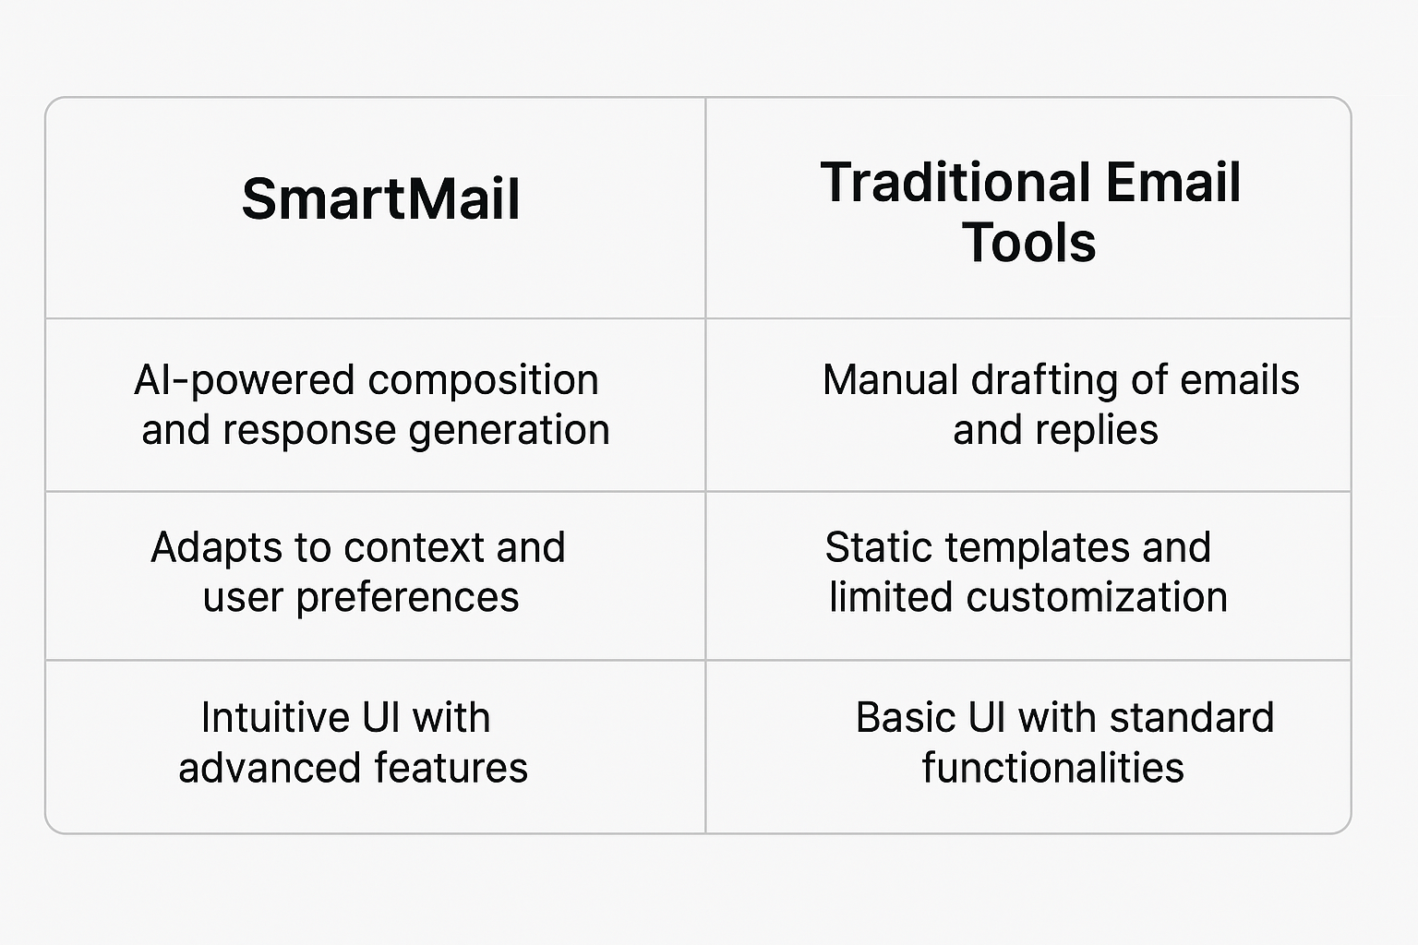

Why We’re Different
Similarity Detection: Uses embeddings to suggest based on past emails.
Caching: Reduces API calls with suggestion and embedding caches.
Security: Encrypted email history ensures privacy.
Extensibility: Modular design for future features (e.g., multi-language support).

Slide 9

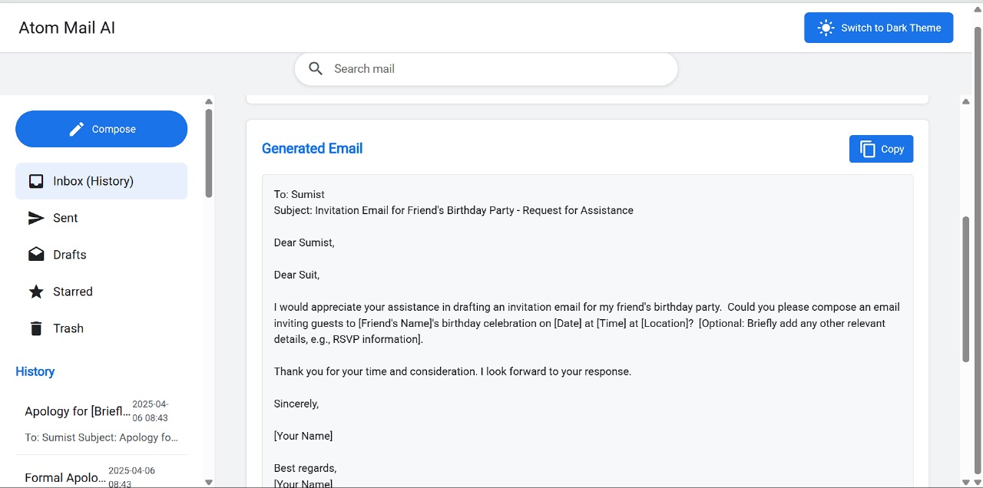
See It in Action
Live demo or pre-recorded video showing:
Generating an email from a prompt.
Refining text (e.g., formalize tone).
Viewing encrypted history.
Note: Keep it short (30-60 seconds) and rehearsed.

Slide 10

Who Benefits?
Professionals: Faster client communication.
Students: Polished emails for professors or internships
Small Businesses: Consistent tone and secure records.
Stat: "Reduce email drafting time by 70%!"

Slide 11
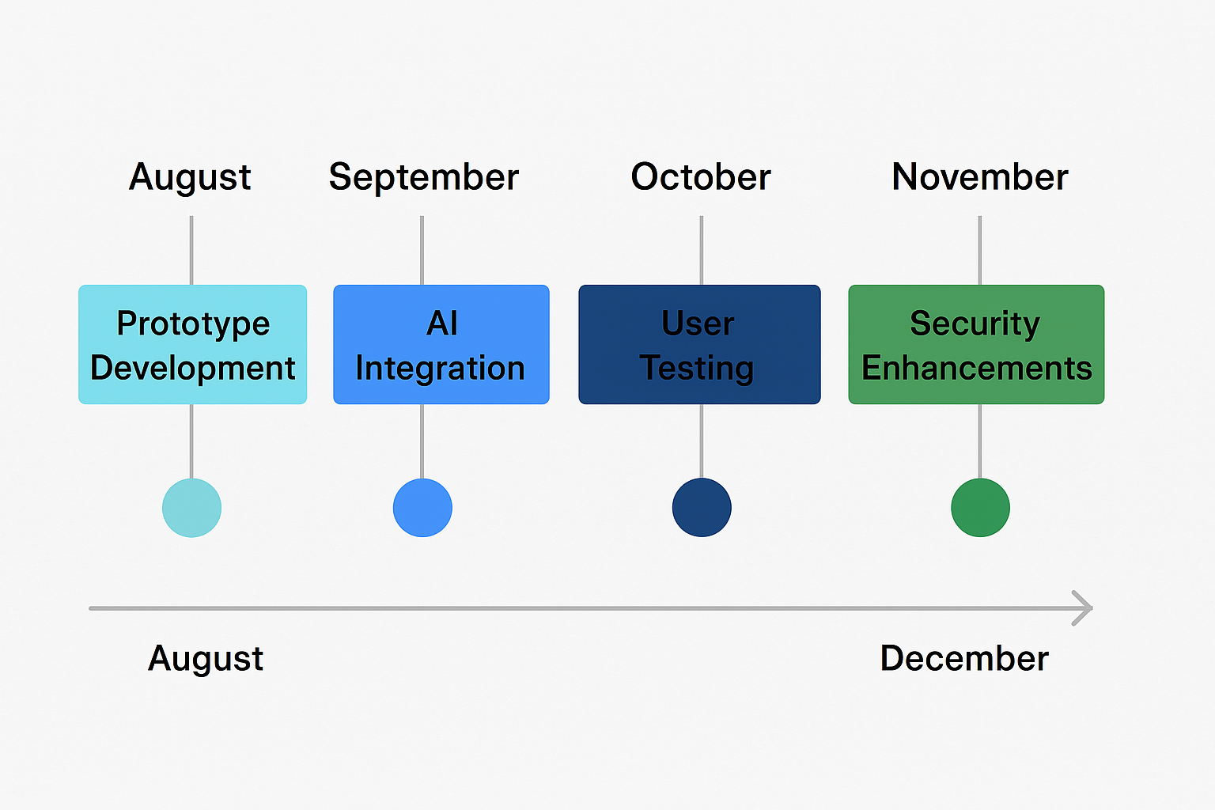

What’s Next?
Integrate more AI models (e.g., sentiment analysis).
Add multi-user support with authentication.
Mobile app version.
Real-time collaboration features.

Slide 12

Our Journey
Challenge: Managing API rate limits → Solved with caching.
Challenge: Ensuring encryption reliability → Tested with Fernet.
Learning: Balancing AI creativity with concise outputs.

Slide 13
Thank you very much!

